Slide 1
CSE Course: STAT-2111 Course title: Theory of Statistics
Prof. Md. Aminul Hoque, PhD
HP: 01715361973
E-mail: aminul@ru.ac.bd
OR
mdaminulh@gmail.com

Slide 2
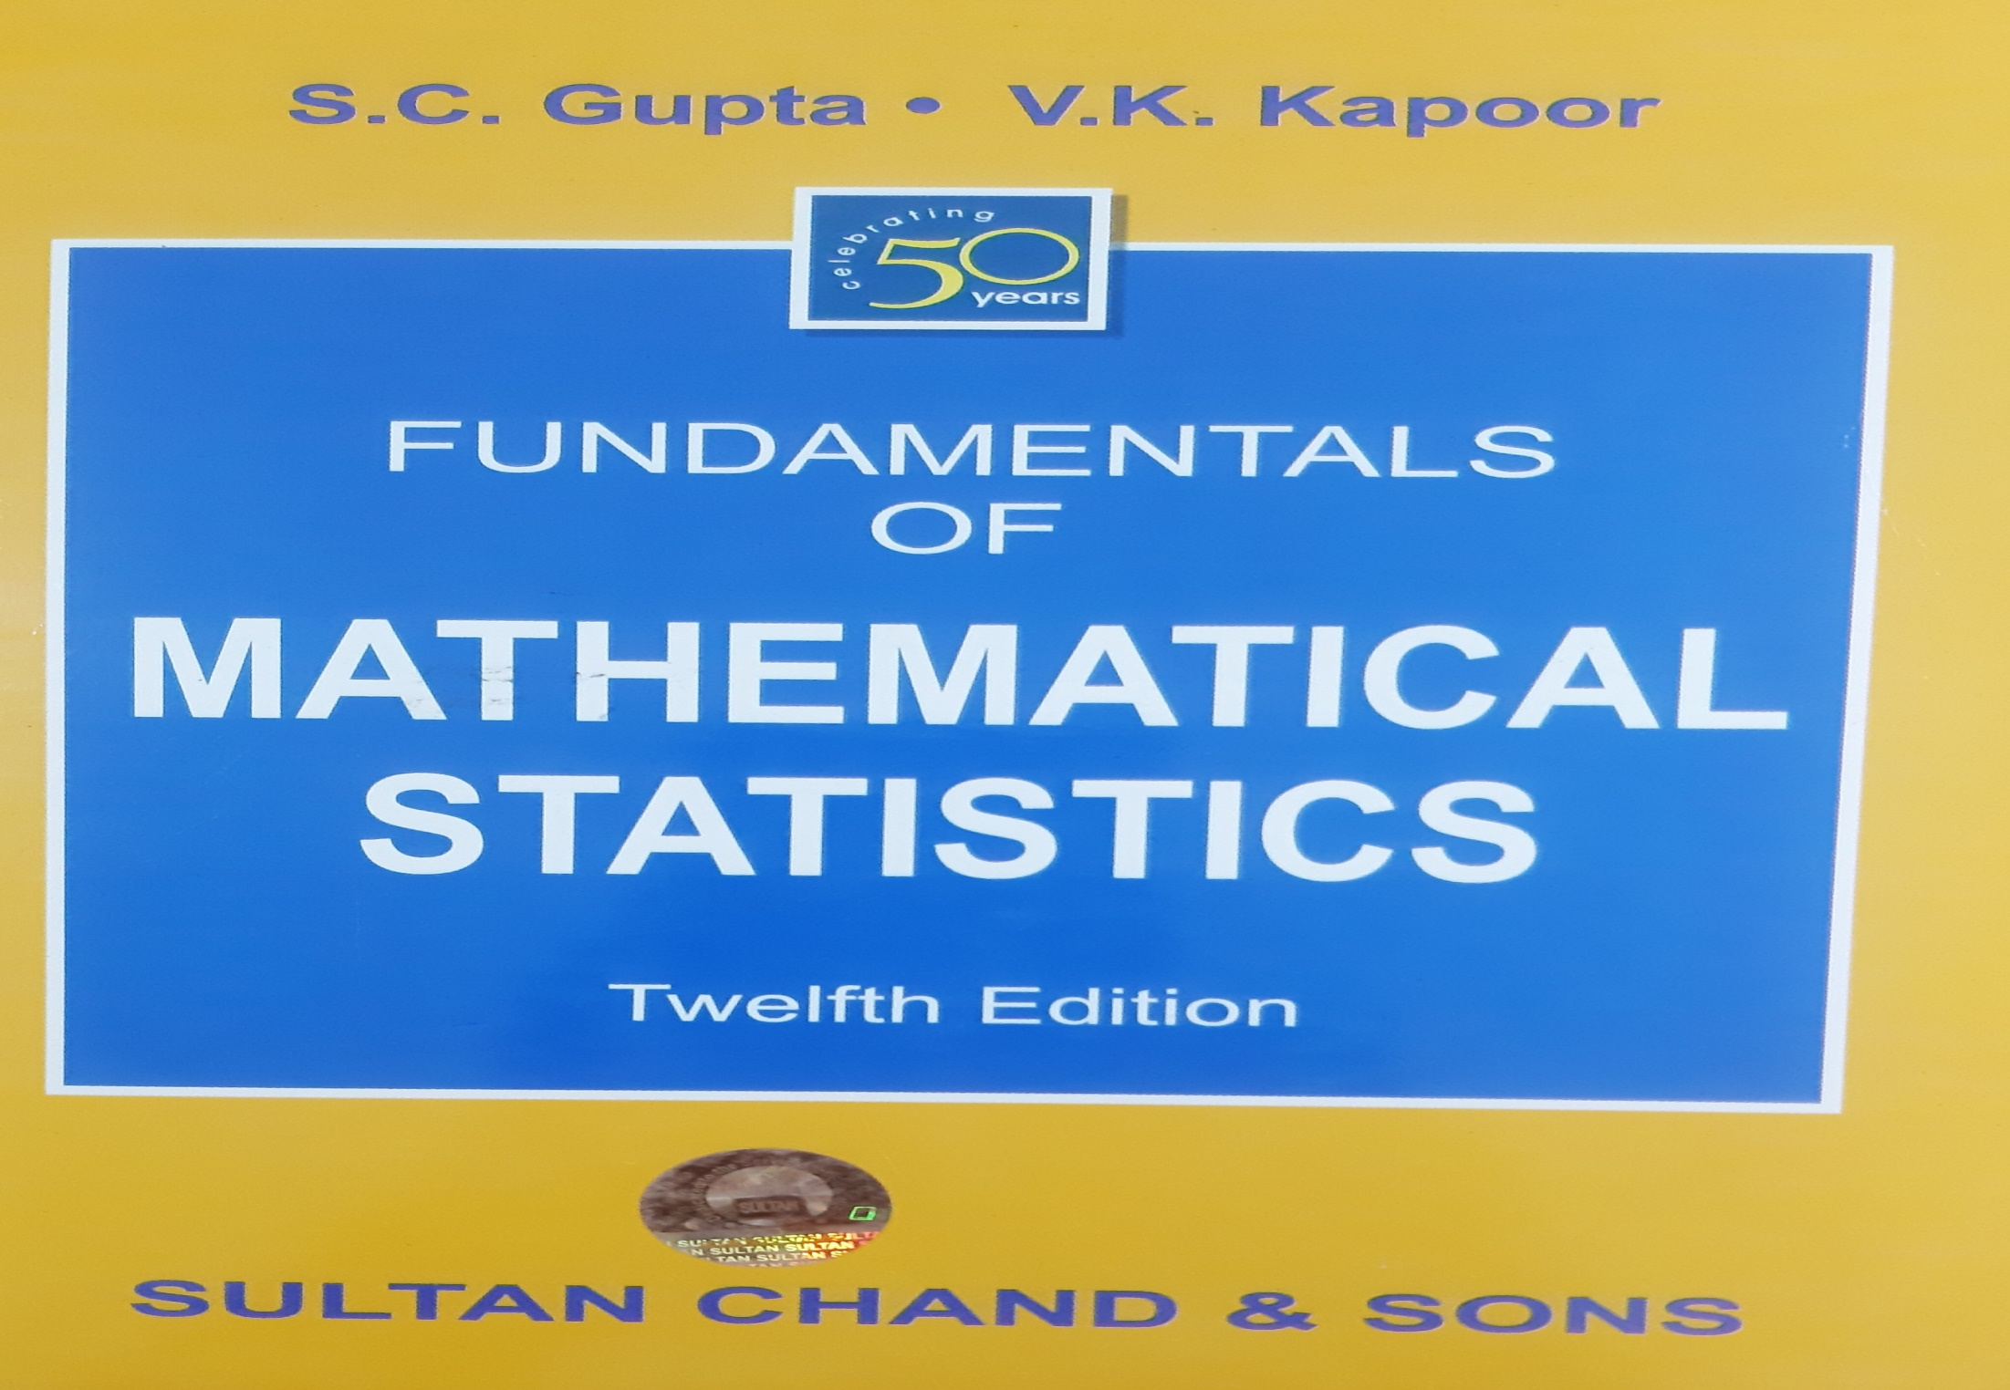
Reference

Slide 3
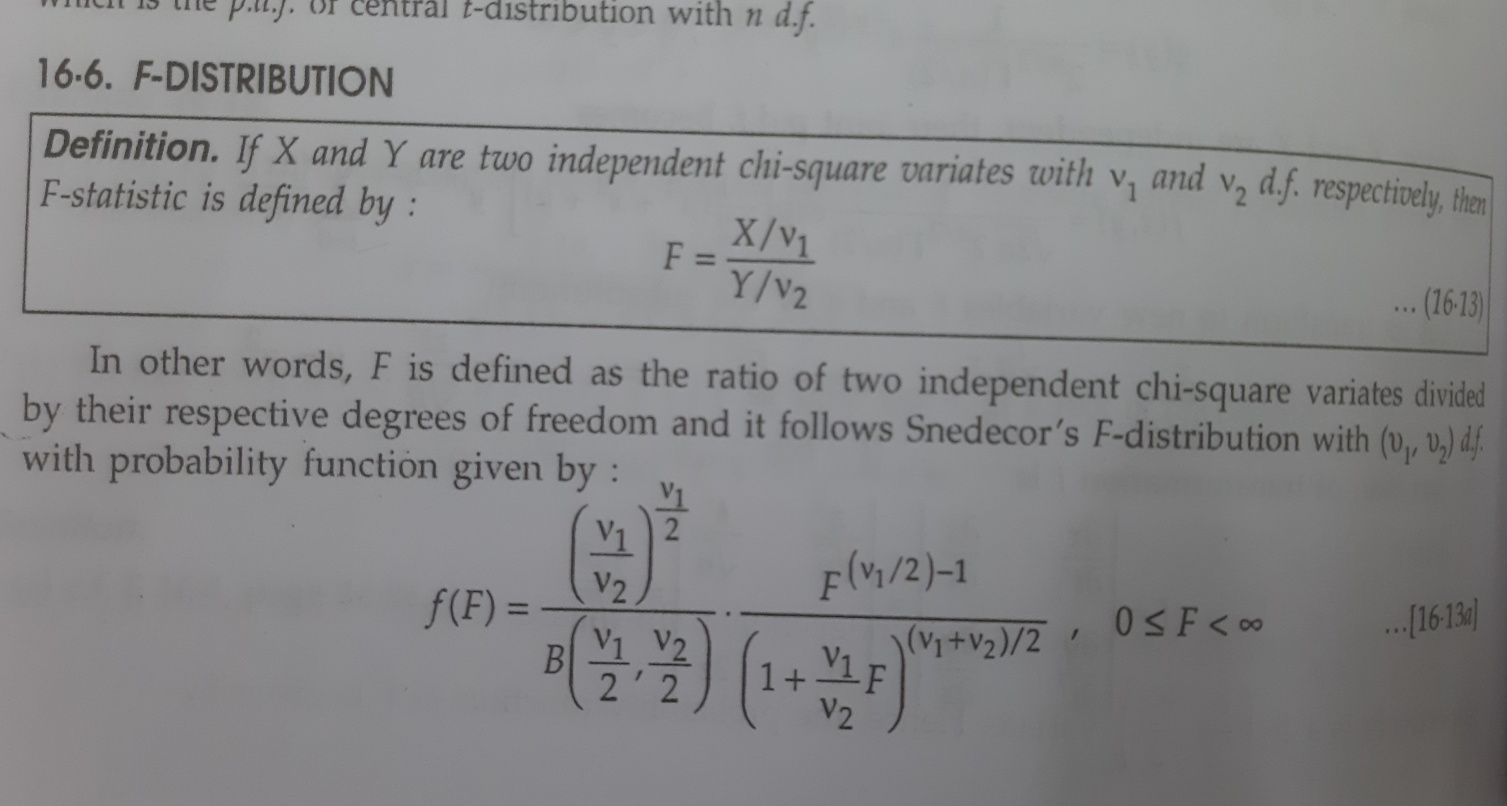
F-Distribution
In probability theory and statistics, the F-distribution or F-ratio, also known as Snedecor's F distribution or the Fisher–Snedecor distribution (after Ronald Fisher and George W. Snedecor) is a continuous probability distribution that arises frequently as the null distribution of a test statistic, most notably in the analysis of variance (ANOVA) and other F-tests.

Slide 4
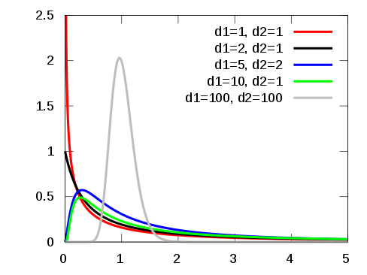
Graph of F-distribution

Slide 5
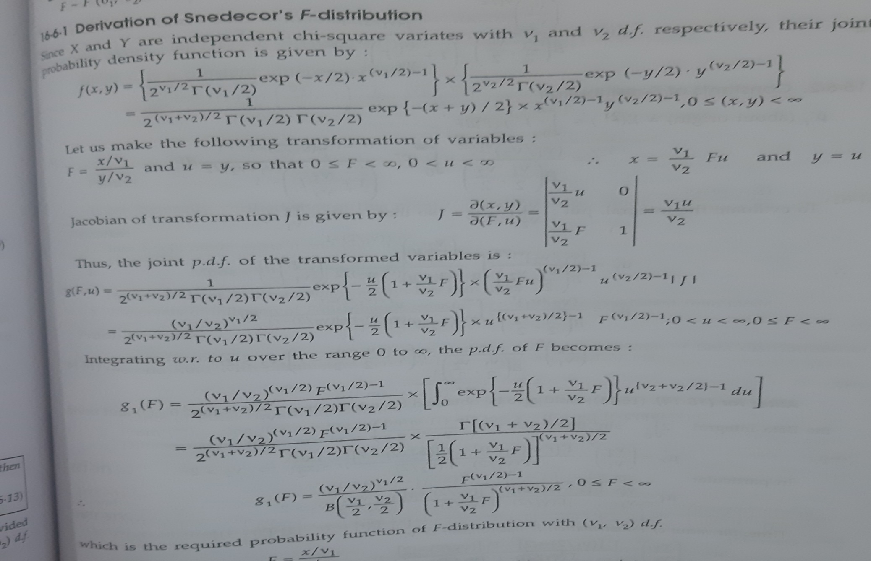
Derivation of F-Distribution

Slide 6
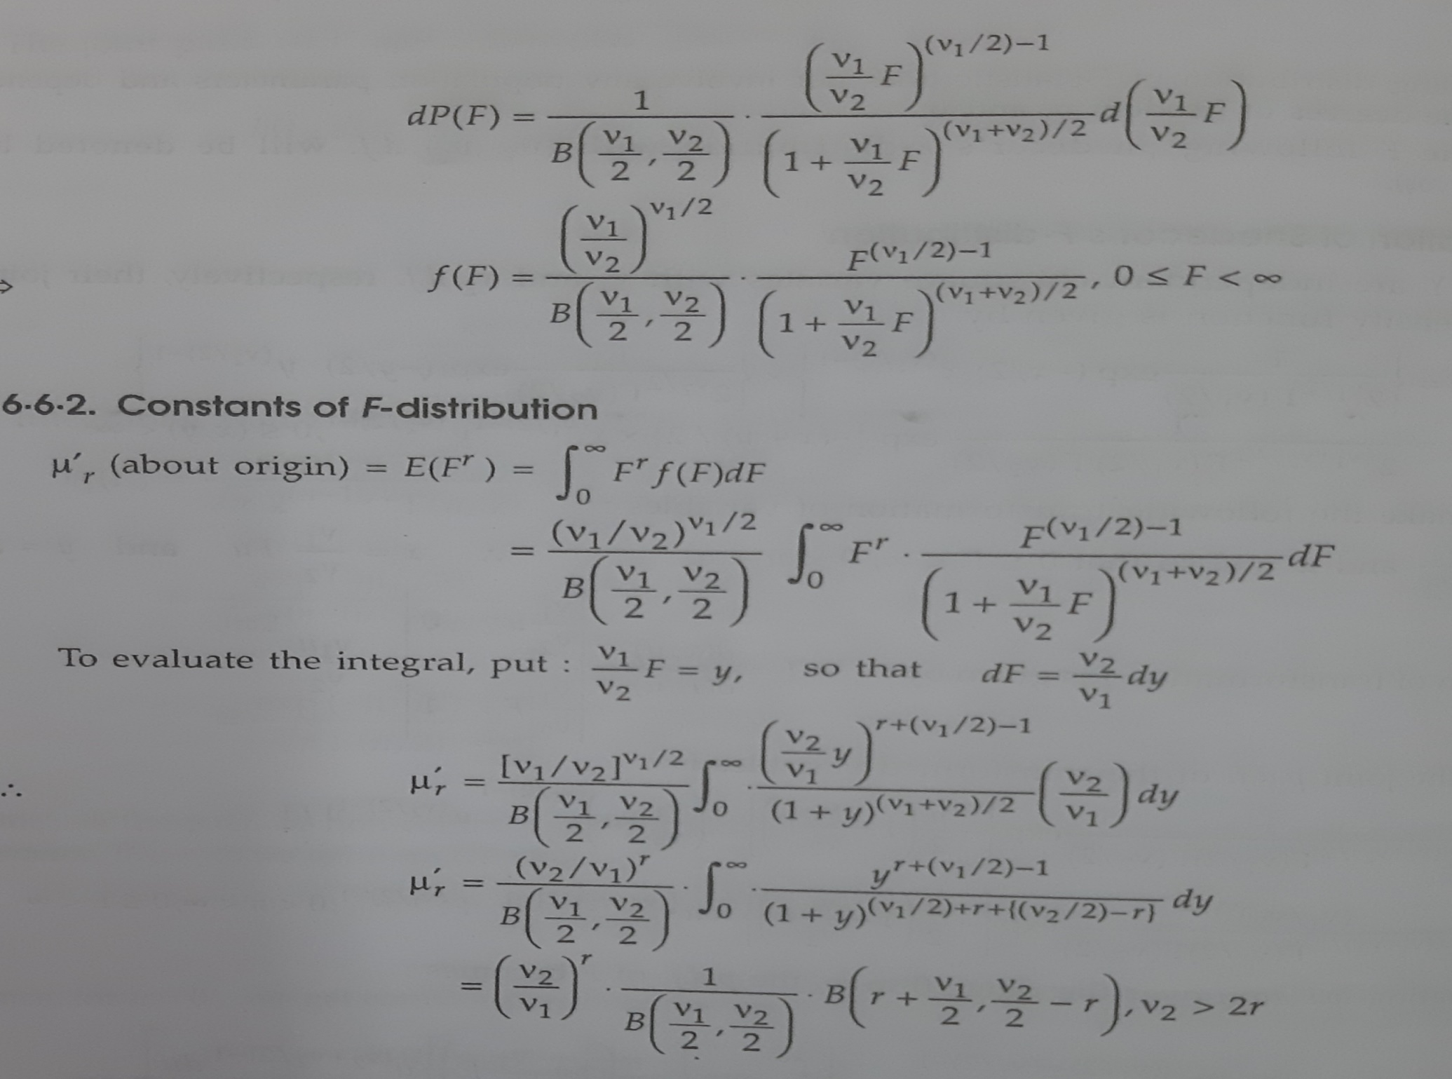

Slide 7
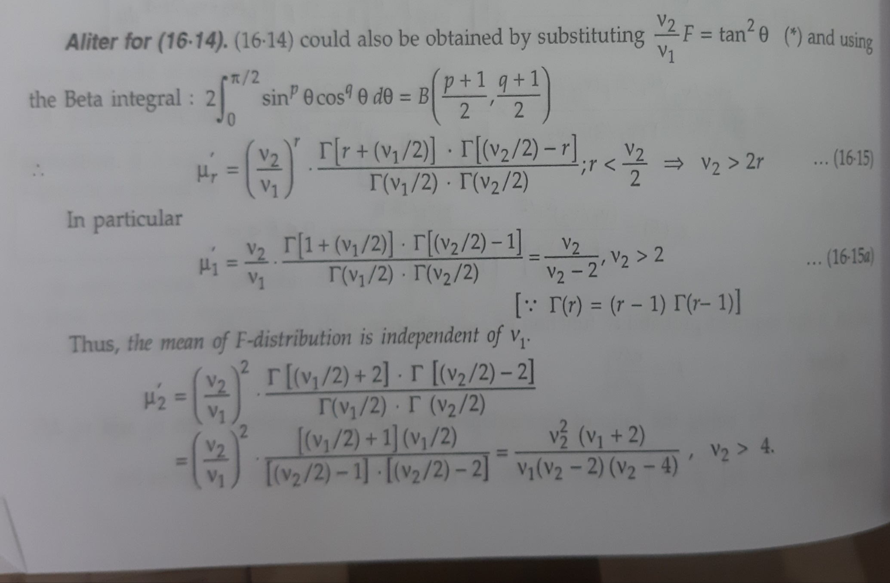
Aliter for derivation

Slide 8
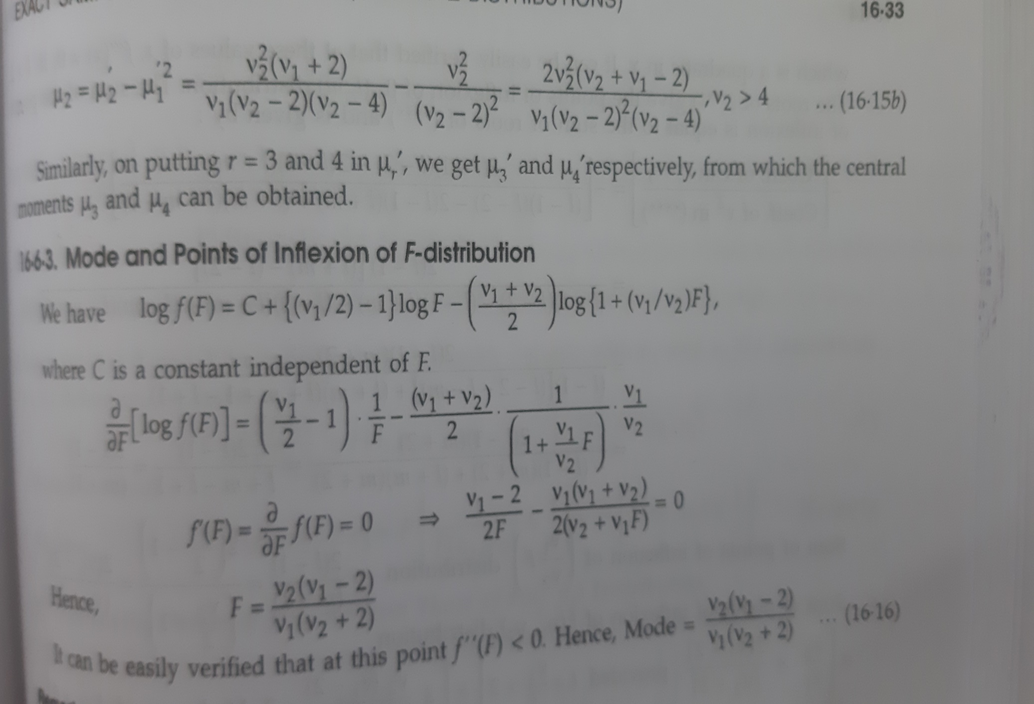
Mode of F-distribution

Slide 9
Applications of F-distribution
F-statistics has many applications in Statistics as well as any other scientific filed of research. However, some applications of F-statistic in Statistical theory are given below:
1. F-test for equality of Two Population variance
2. F-test for testing the significance of an observed multiple correlation coefficient
3. F-test for testing the significance of an observed sample correlation ratio
4. F-test for testing the linearity of Regression
5. F-test for testing equality of means
6. F is used for analysis of variance.

Slide 10
